Slide 1
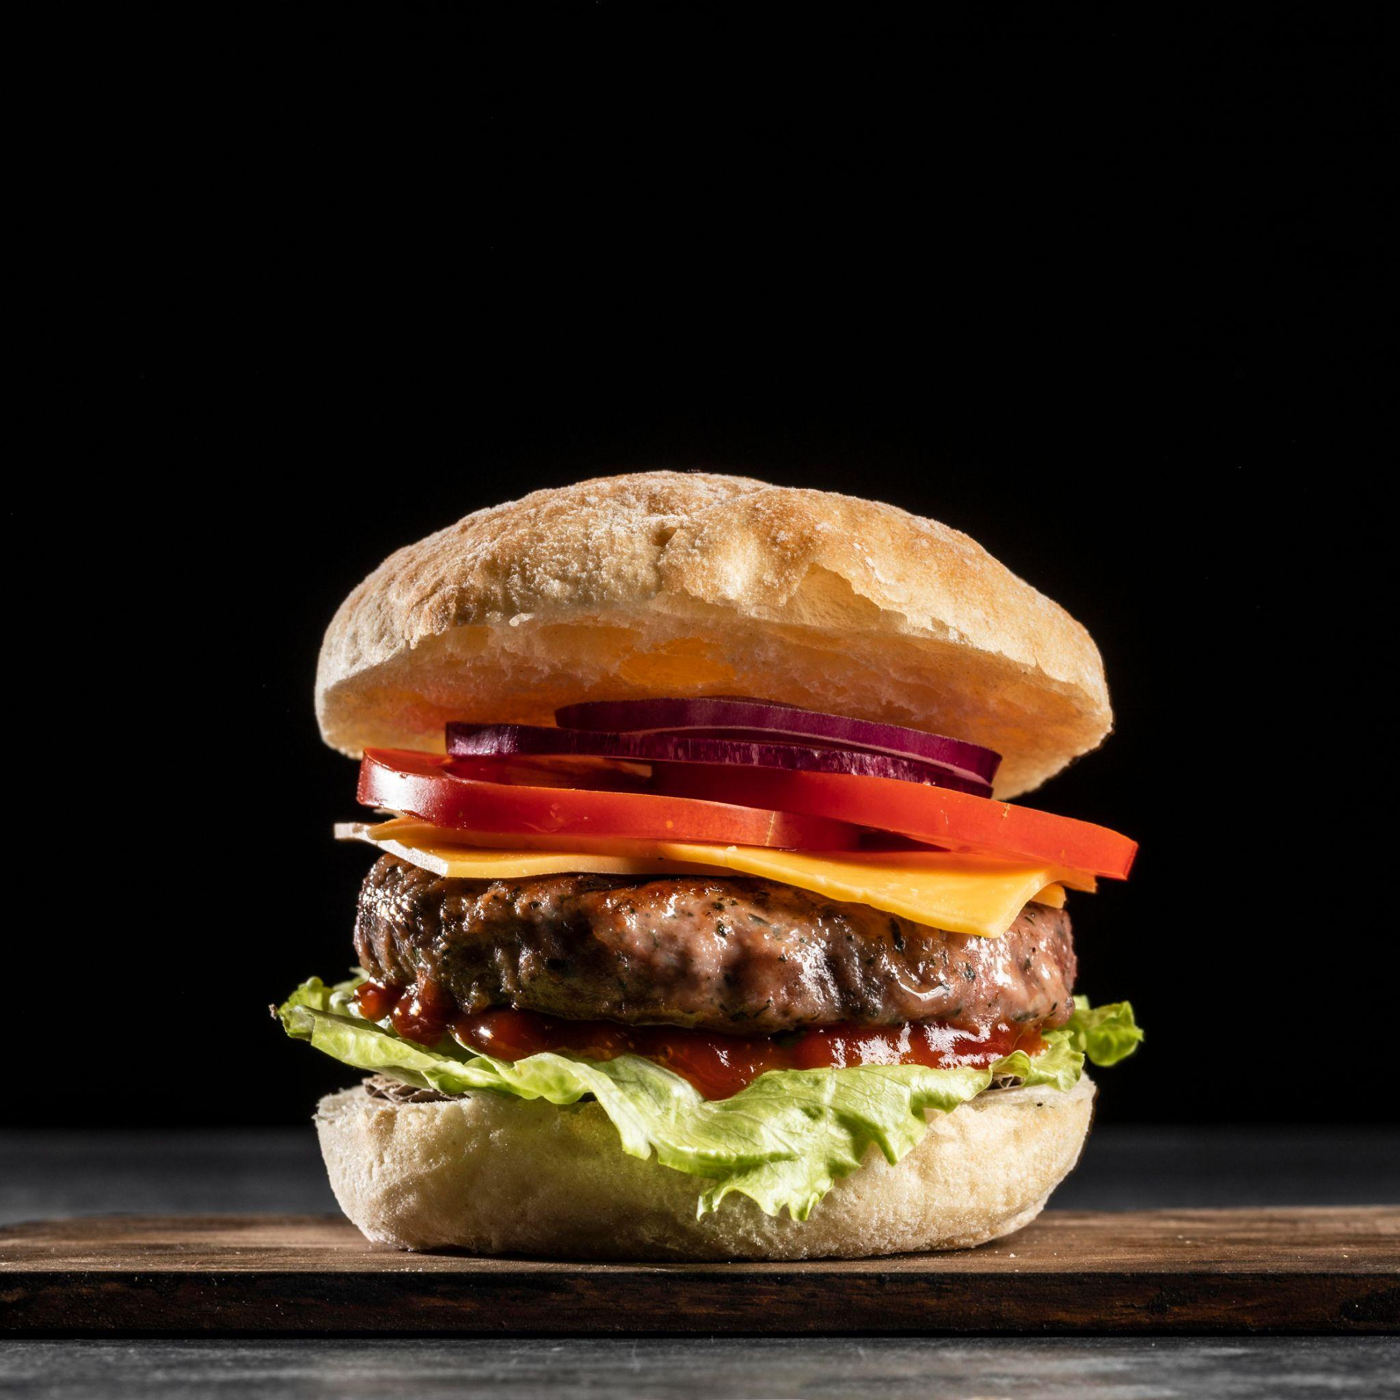
Fast Food Restaurant Analysis report
By group 2: Chenyi Wei, Zhou Li, Jenny Wang, Sicheng Yun

Slide 2
Contents Overview
01
02
03
04
05
06
Topic
Blueprint
Validity
A brief introduction of our analytical topic
Analytical process and the advantages & disadvantages of each of them
Overview of how do we check the validity of our dataset
Analytical result
Conclusion
Summary of the analytical results
Recommendation & future application
Source of customers
Notes:
Intro-Jenny
Blueprint-Jenny
Analytical result & Conclusion: Zhou, Jenny, Soso
Validity: Canny

Slide 3
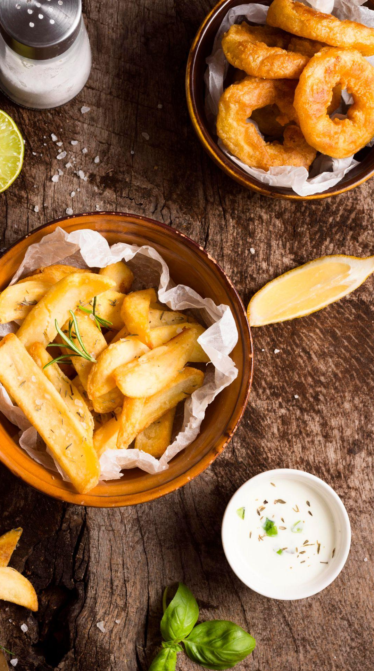
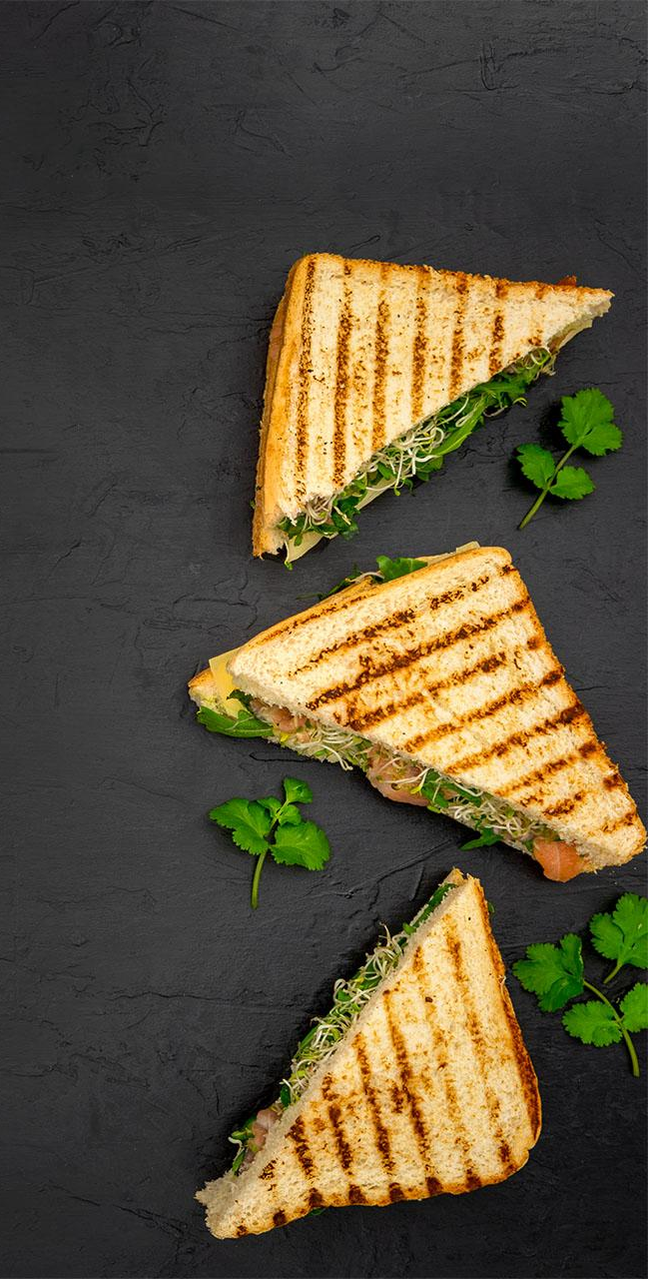
01
Topic

Slide 4
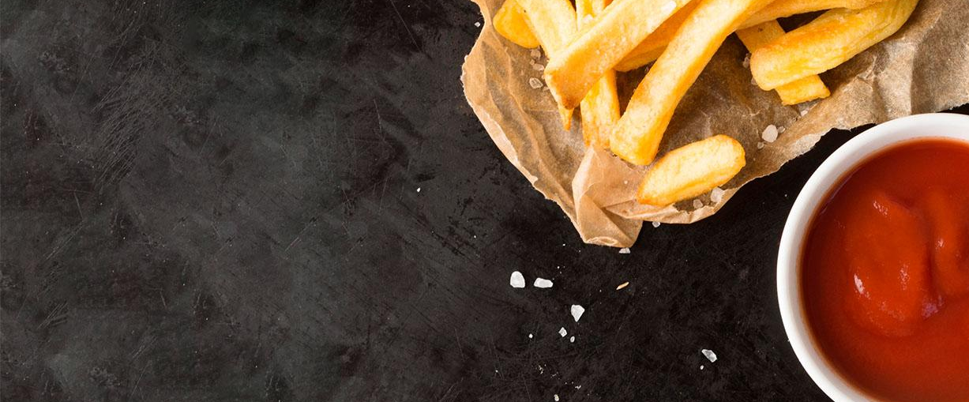
Fast-food Restaurant
Quarantine Policy
In-store traffic of fast-food restaurant: increase, decrease, or keep the same?
Question: Does fast-food restaurant’s pattern of in-store traffic keep the same before and after the Quarantine Policy?

Slide 5
02
Blueprint
Filtering process

Slide 6
Blueprint evolution
Aggregation
inner-joint
Naics_code
-Check: recorded number of brands in Boston v. number of brands in the dataset
-Find the commonplace of most famous fast-food restaurant
- Naics code for fast-food restaurant: 722513

Slide 7
03
Validity
Overview of how do we check the validity of our dataset

Slide 8



Slide 9

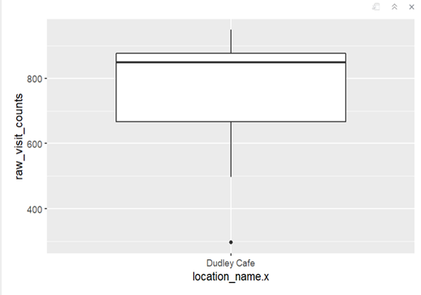
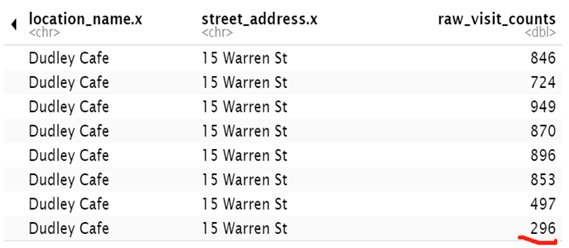

Slide 10
04
Analytical Results
Summary of the analytical results

Slide 11
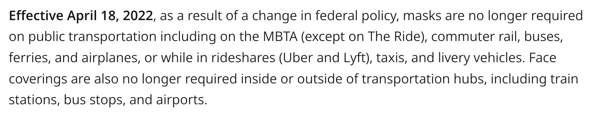
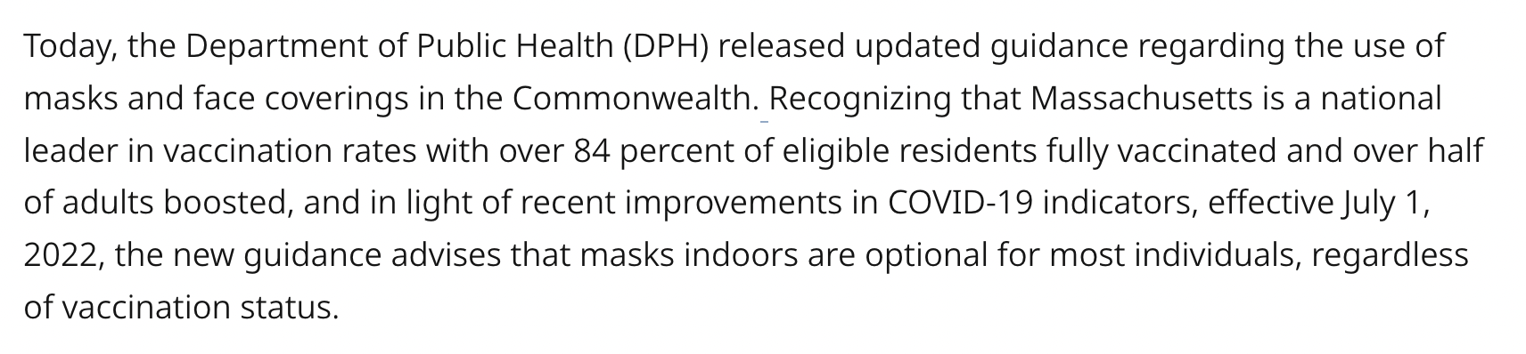
Covid-19 policy’s impact
https://www.mass.gov/info-details/covid-19-travel
https://www.mass.gov/news/massachusetts-department-of-public-health-releases-updated-mask-advisory

Slide 12
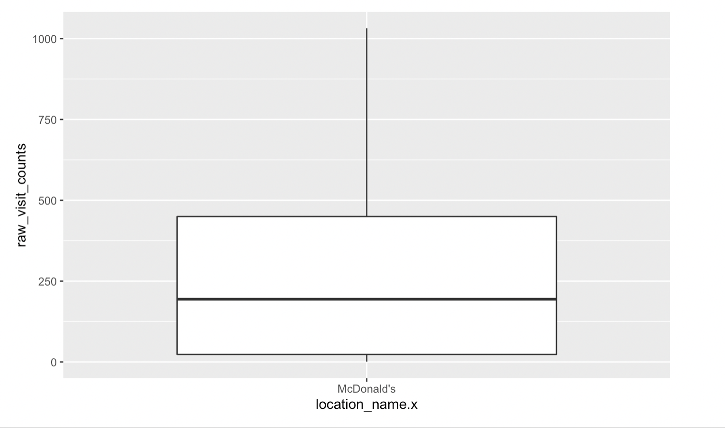
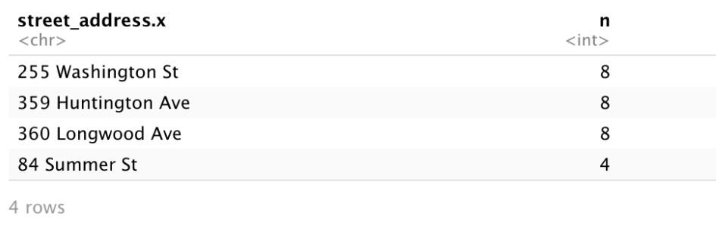
Covid-19 policy’s impact
see the statistical feature of the raw visit number
3rd Qu.is 1495 , so we identify the restaurants whose raw visit number greater than 1500 as first group.
1st Qu. is 252.0, so we identify the restaurants whose raw visit number greater than 252 and less than 3000 as second group.
we identify the restaurants whose raw visit number less than 252 as third group.
remove the outliers by box plot and location of data with missing months by distribution
we select the most representative location of every group top 10 restaurants

Slide 13
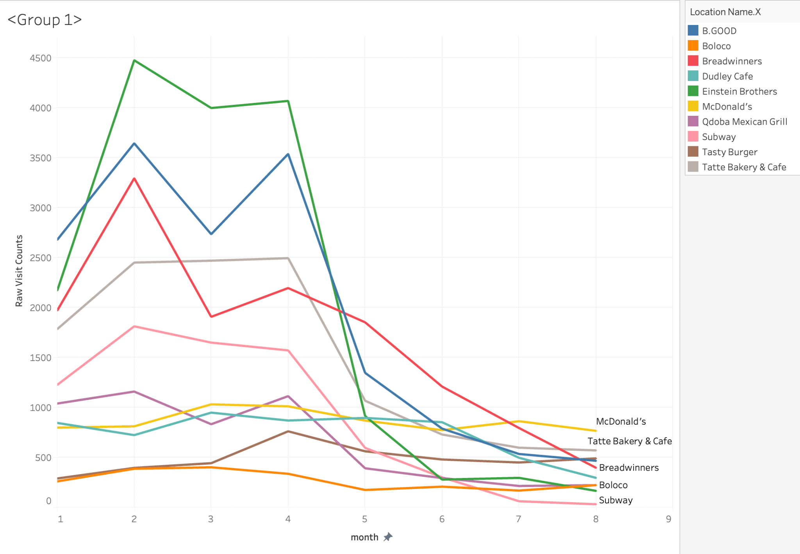
Covid-19 policy’s impact

Slide 14
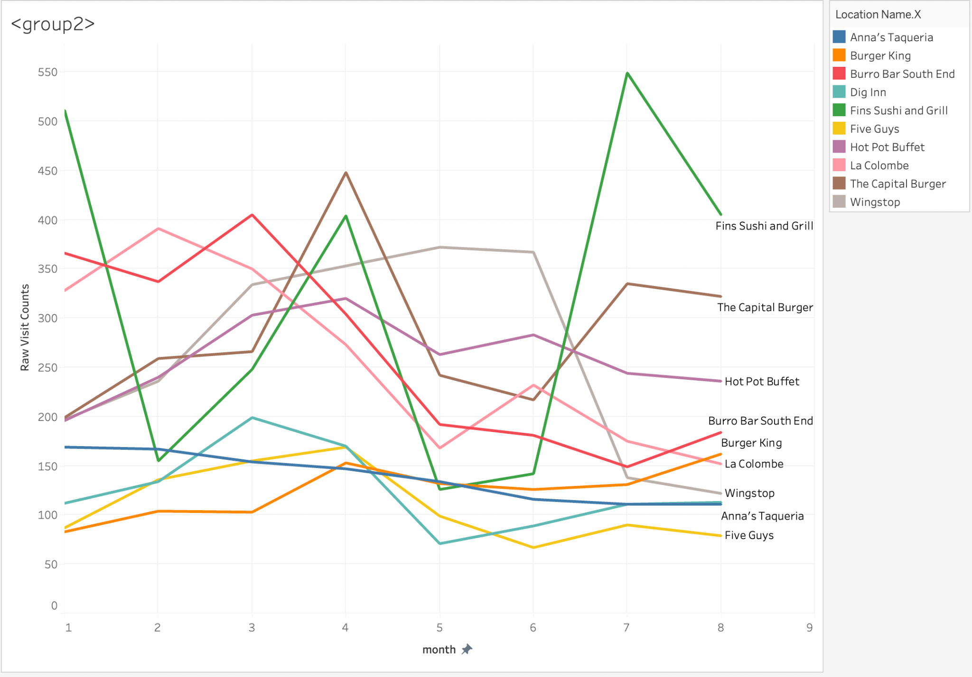
Covid-19 policy’s impact

Slide 15
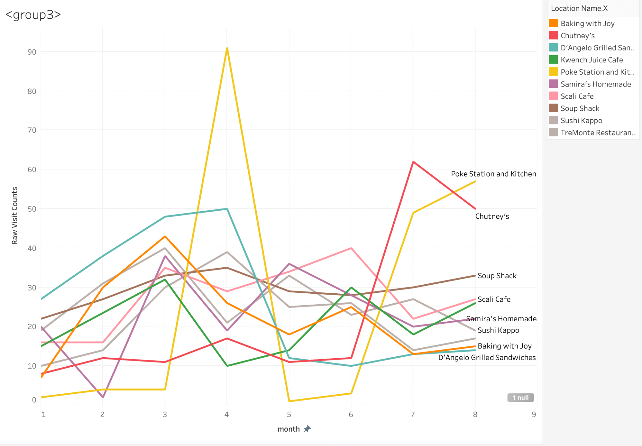
Covid-19 policy’s impact

Slide 16
Covid-19 policy’s impact
the covid-19 policy has the greatest impact on popular and large restaurants with a lot of branches stores.

Slide 17
04
Conclusion
Potential reason & Future application

Slide 18
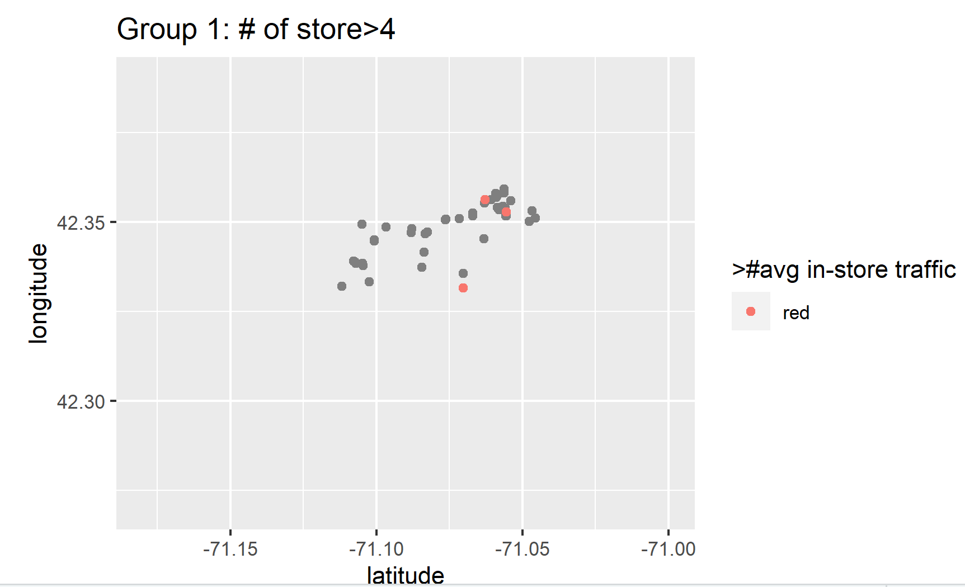
Distribution
Distribution of group 1’s stores vs. Distribution of other stores
Short term
Long term
Write your goal here
Write your goal here
Write your goal here
Write your goal here
Write your goal here
Write your goal here
Write your goal here
Write your goal here
Write your goal here
Write your goal here
Write your goal here
Write your goal here
Write your goal here
Write your goal here

Slide 19
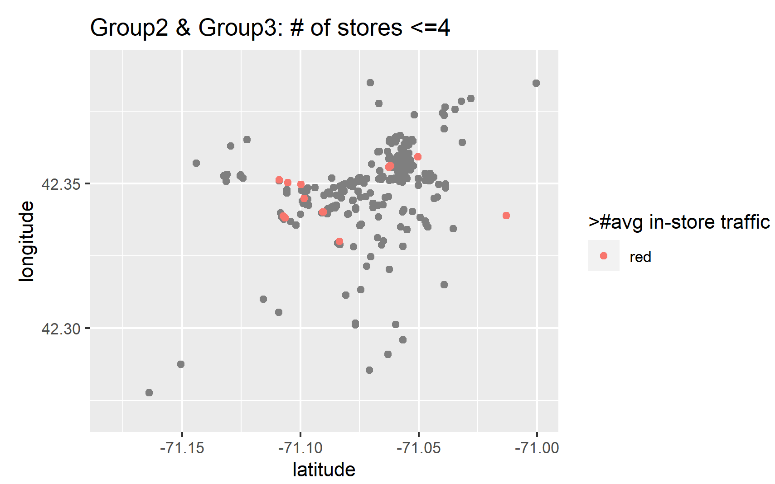
Distribution
Distribution of group 1’s stores vs. Distribution of other stores
Short term
Long term
Write your goal here
Write your goal here
Write your goal here
Write your goal here
Write your goal here
Write your goal here
Write your goal here
Write your goal here
Write your goal here
Write your goal here
Write your goal here
Write your goal here
Write your goal here
Write your goal here

Slide 20
Distribution
Distribution of group 1’s stores vs. Distribution of other stores
Brands with stores<=4
Brands with stores>4
Comparably spread out
Stores with more than avg in-store traffic gather in a competitive area
More concentrate
Stores with more than avg in-store traffic gather in a competitive area

Slide 21
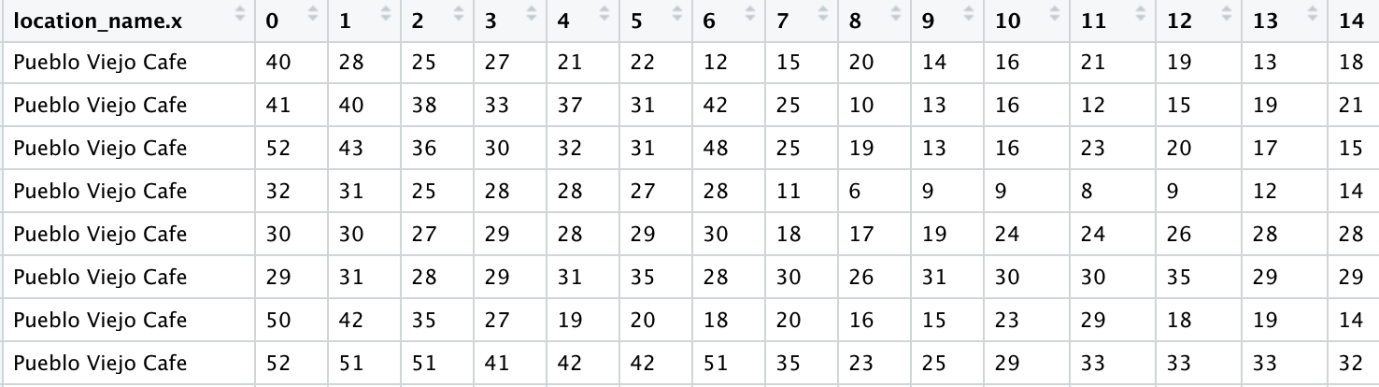
Time Preferences
Example distribution
Short term
Long term
Write your goal here
Write your goal here
Write your goal here
Write your goal here
Write your goal here
Write your goal here
Write your goal here
Write your goal here
Write your goal here
Write your goal here
Write your goal here
Write your goal here
Write your goal here
Write your goal here

Slide 22
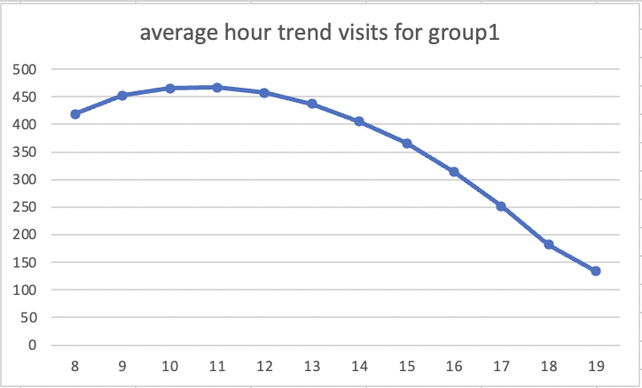
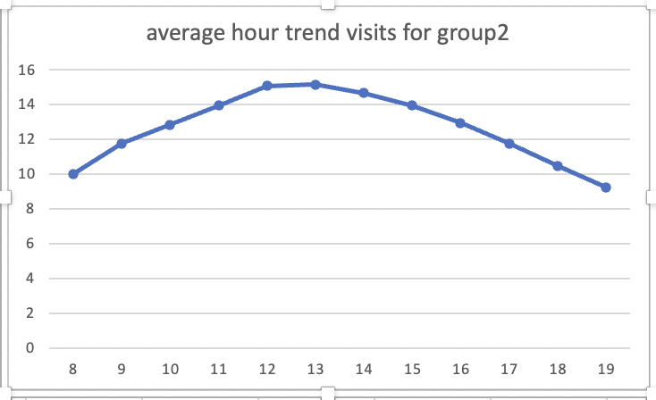
Trend for Hour
Short term
Long term
Group 1 has most of the visits between 9AM to 12PM, Group 2 has most of the visits between 12PM to 14PM
Special promotion to further boost the visits

Slide 23
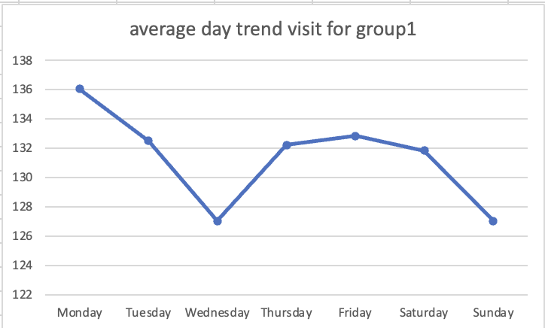
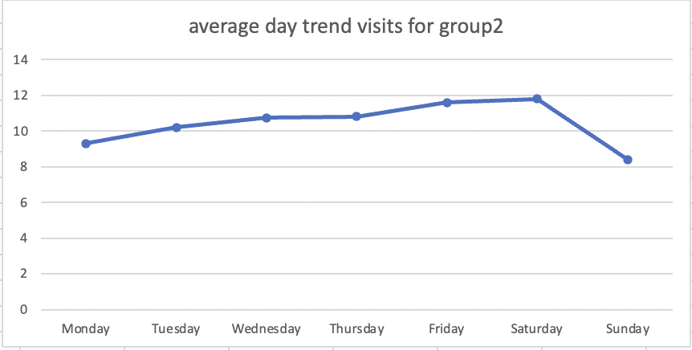
Trend for Day
Short term
Long term
Monday is the hottest day for group 1, Saturday is the hottest day for group 2
Disperse stores to reduce the difference between daily visit changes and risks that may be caused by external factors

Slide 24
06
Source of customers
Where are the customers coming from

Slide 25



Slide 26

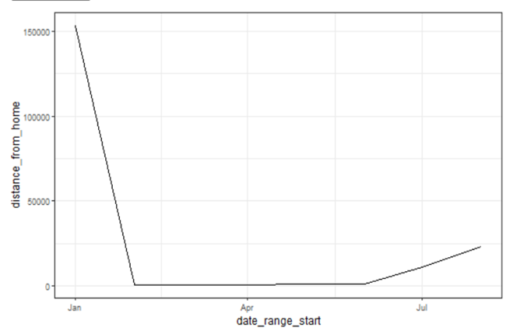
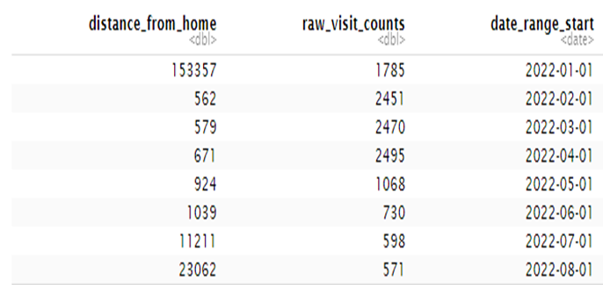

Slide 27


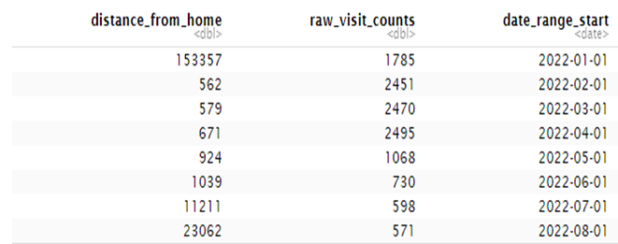

Slide 28

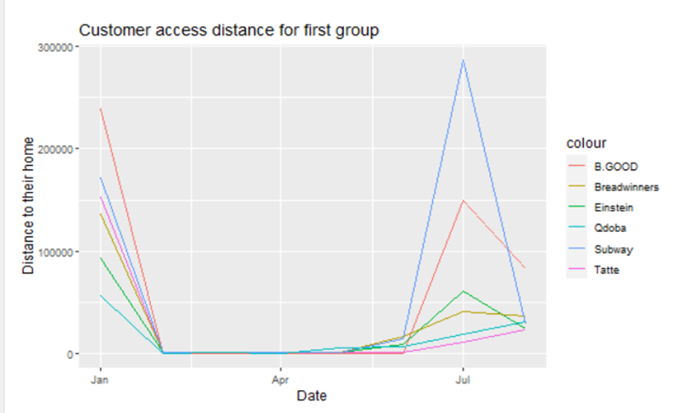


Slide 29
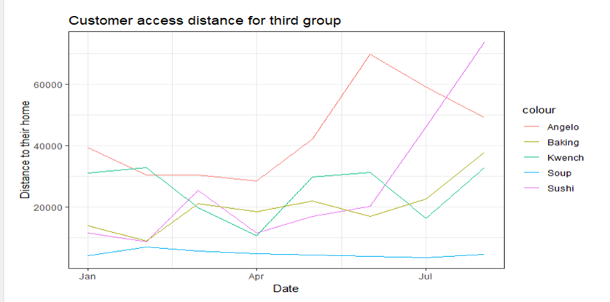

•We can see that the customer visit distance in February to April are smaller, the numbers in July seems are very large, meaning that guests seem to come from far away.
•
•The number is 73KM, which means that half of the customers visiting in this month come from seventy kilometers away.
•
•But I don't think this is an outlier, considering that this period is the holiday of the students, they might be visited from a long distance.

Slide 30
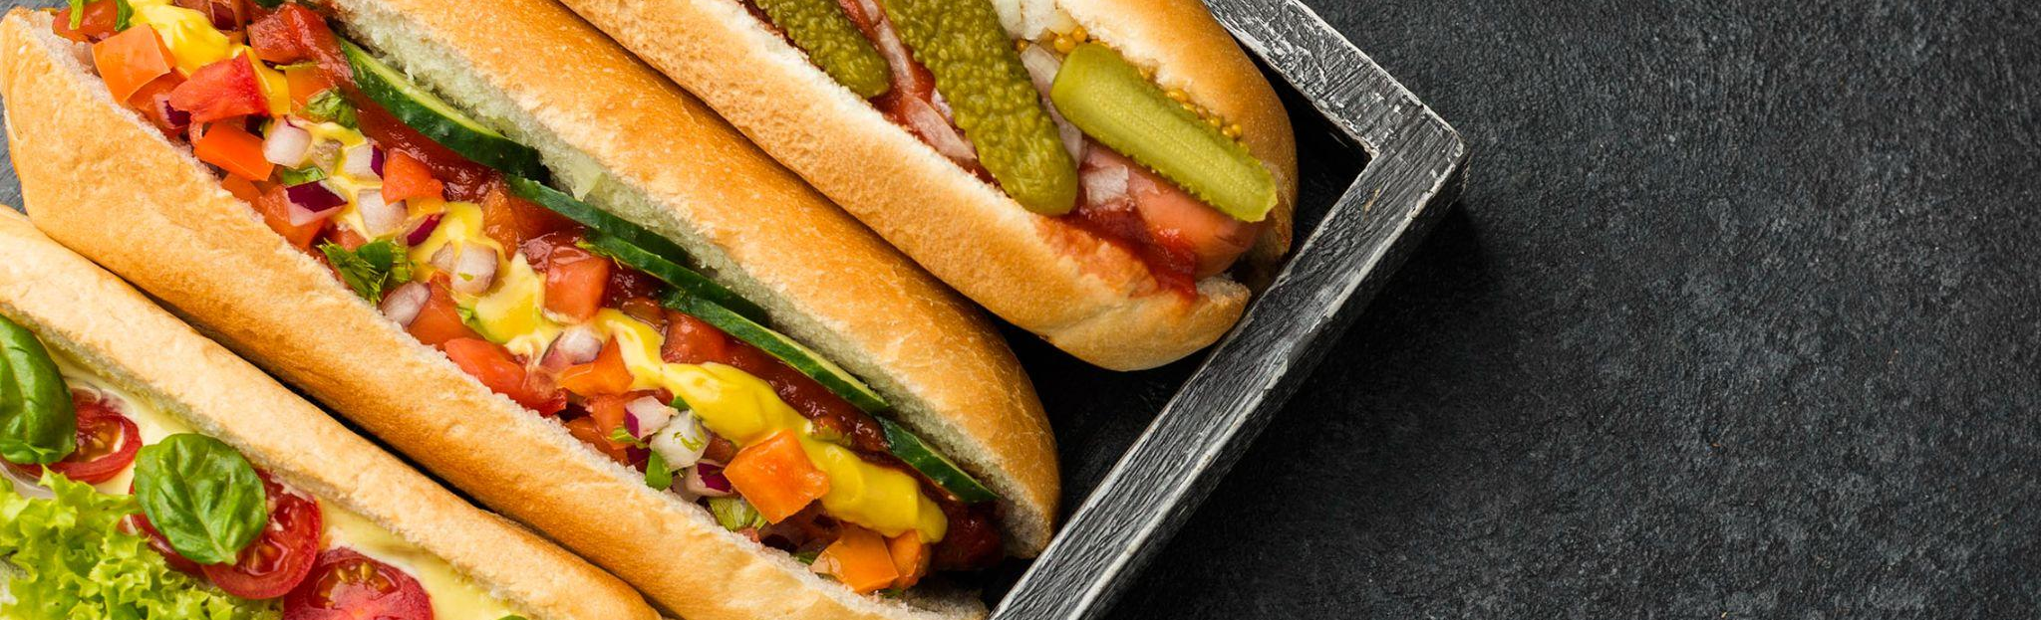
Thank you!

